Slide 1
SNS INSTITUTIONS
GRADE 7 – SCIENCE
LESSON-1 NUTRITION IN PLANTS

Slide 2
TOPICS TO BE COVERED
Types of nutrition
Autotrophic nutrition
Heterotrophic nutrition
Saprophytic and parasitic nutrition

Slide 3
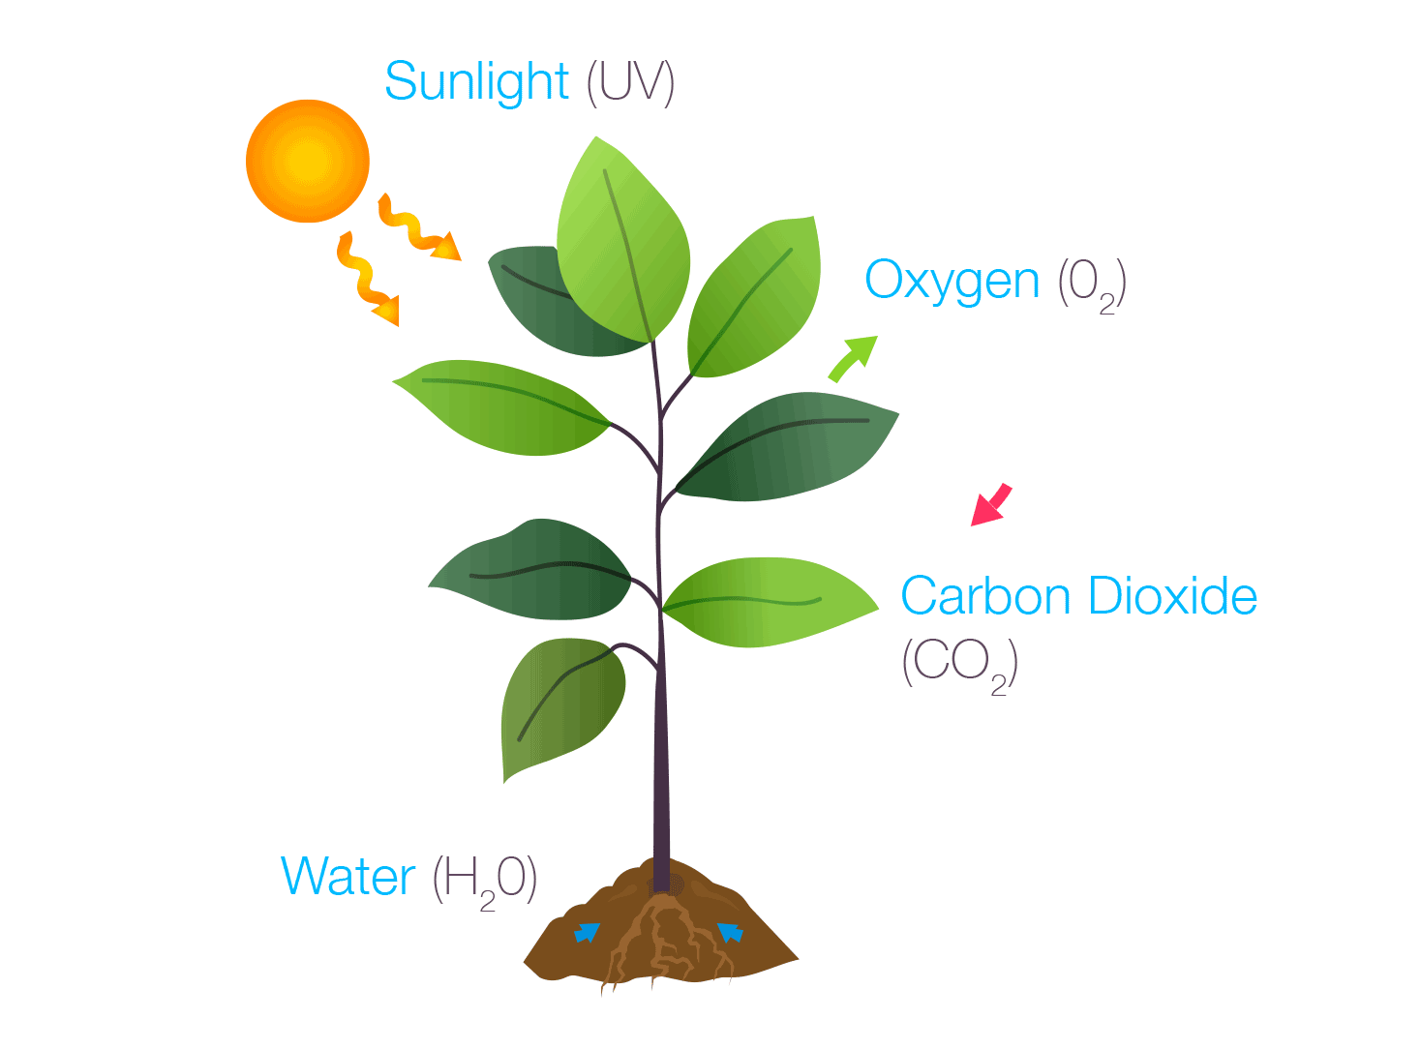
AUTOTROPHIC NUTRITION
The term autotrophic means “auto” means “self” and “trophic” means “nutrition”.
Green plants belong to the category of Autotrophic nutrition.
They prepare food by the process called photosynthesis.

Slide 4
HETEROTROPHIC NUTRITION
The animals, non-green plants cannot prepare their food as they depend on other organism for their food.
This mode of nutrition is called heterotrophic nutrition.

Slide 5
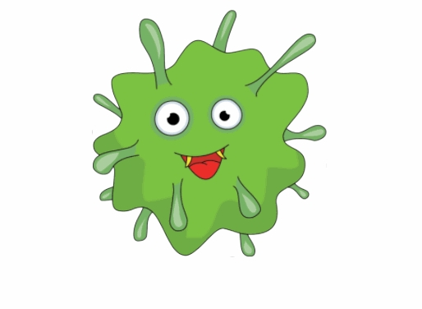
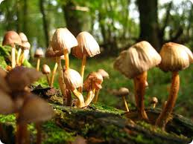
SAPROPHYTIC NUTRITION
The saprophytic plants come under the category of heterotrophic nutrition.
They are the plants which breed on dead and decay organisms. They are also called decomposers.
Example; Bacteria, Fungi, Mushroom

Slide 6
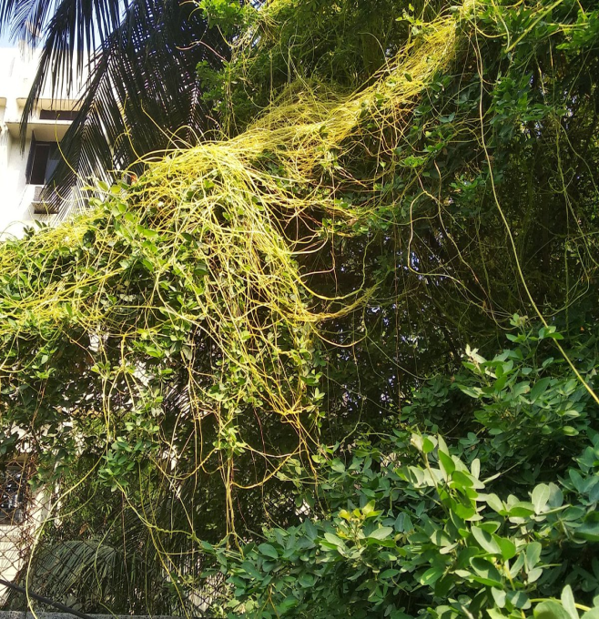
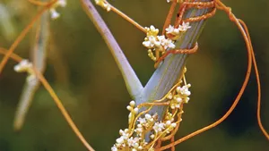
PARASITIC NUTRITION
Parasitic plants do not prepare their own food. Instead they obtain nutrients from other plant where they live and they are called their host.
Examples; Cuscuta, Dodder.

Slide 7
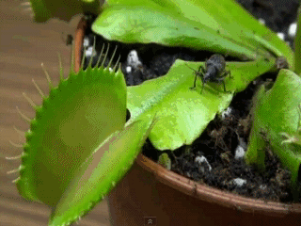
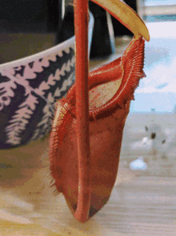
INSECTIVOROUS PLANTS
Some plants poorly develop root systems and they are tend to be nitrogen-deficient. So they absorb nutrients by trapping and digesting insects.
Examples; Pitcher, Venus flytrap

Slide 8
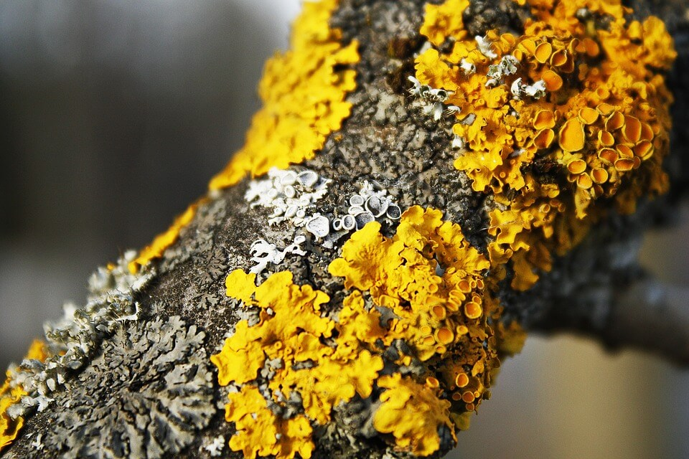
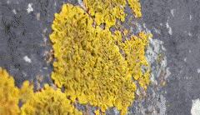
SYMBIOTIC PLANTS
These plants have a mutual relationship which is beneficial to each other without any harm to either of their partner.
Examples; Lichens; They have a mutual relationship with fungi as the photosynthetic partner to provide carbon as the energy source.

